Slide 1
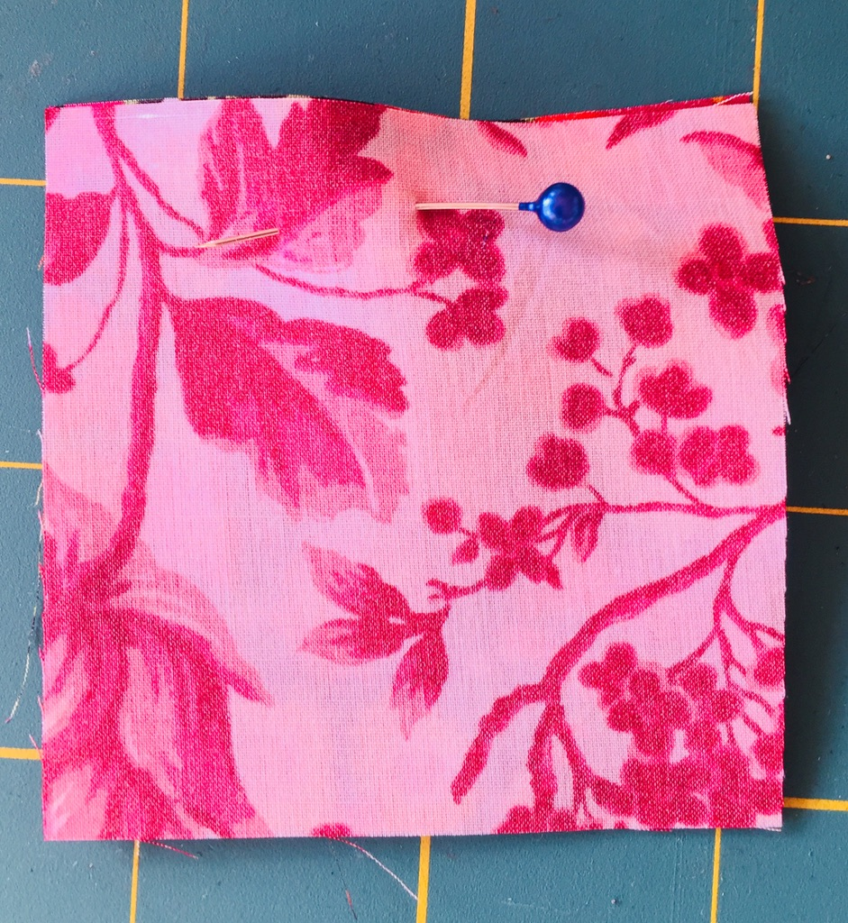
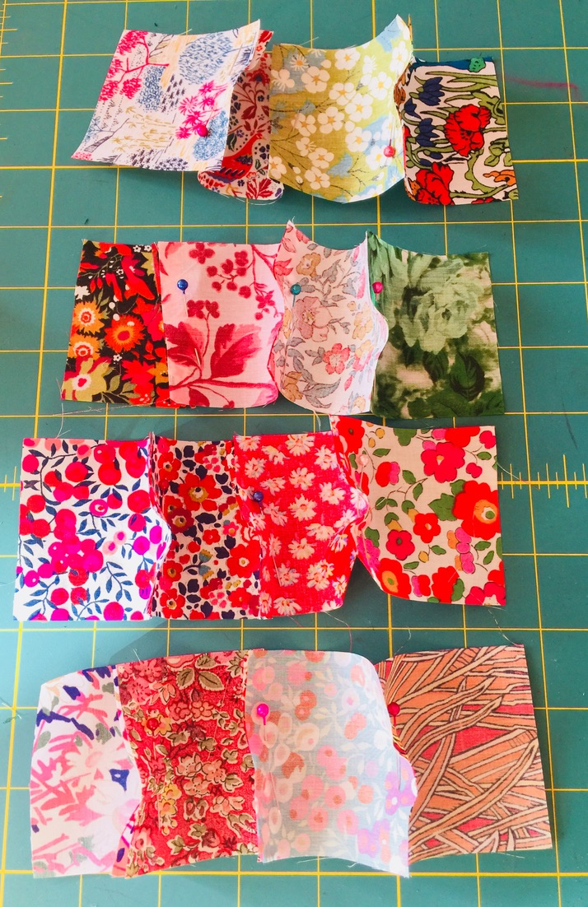
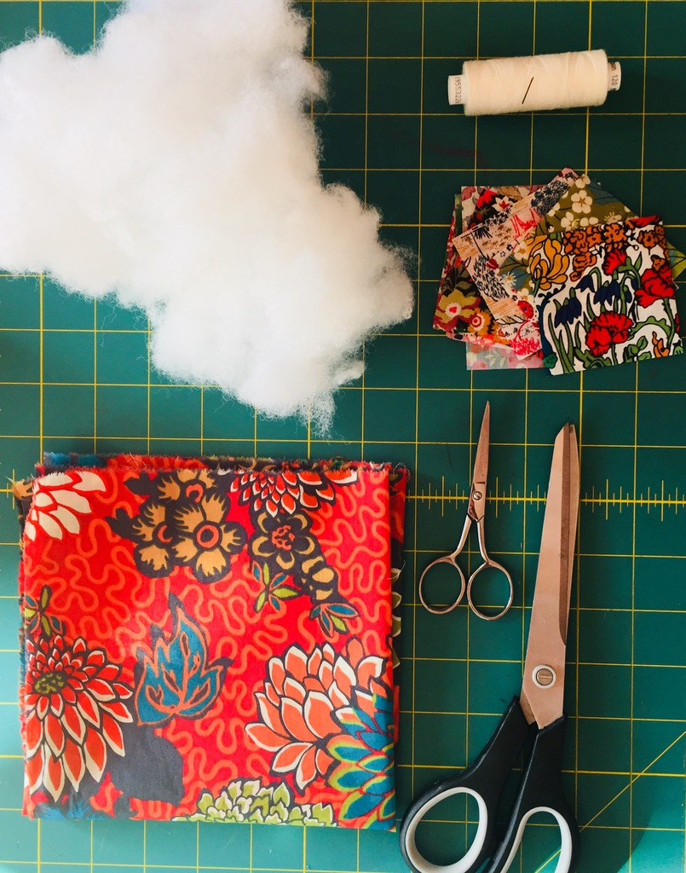
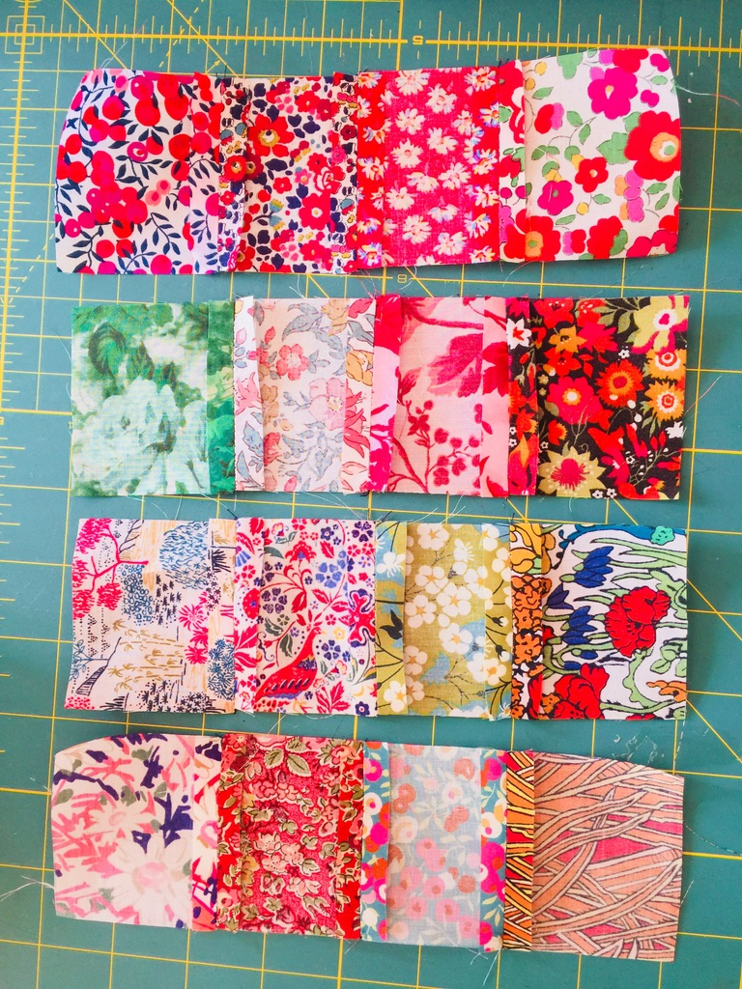
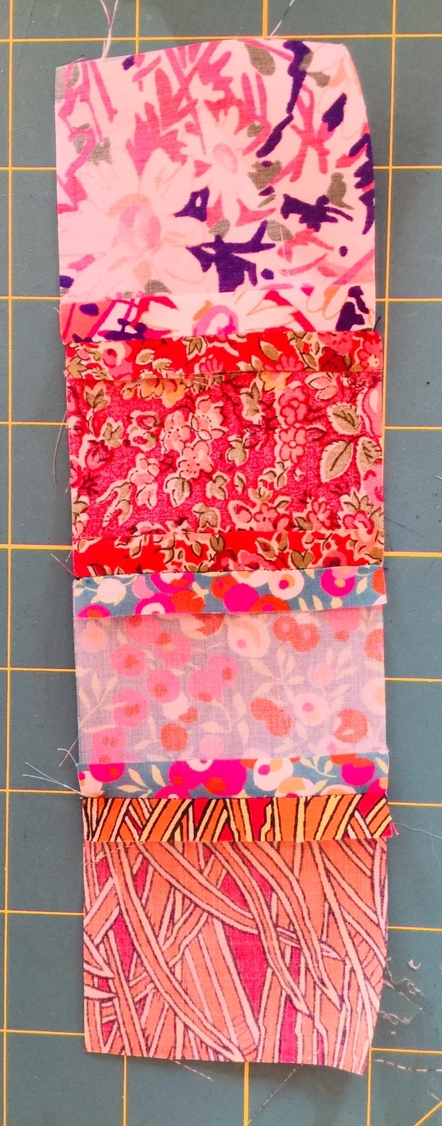
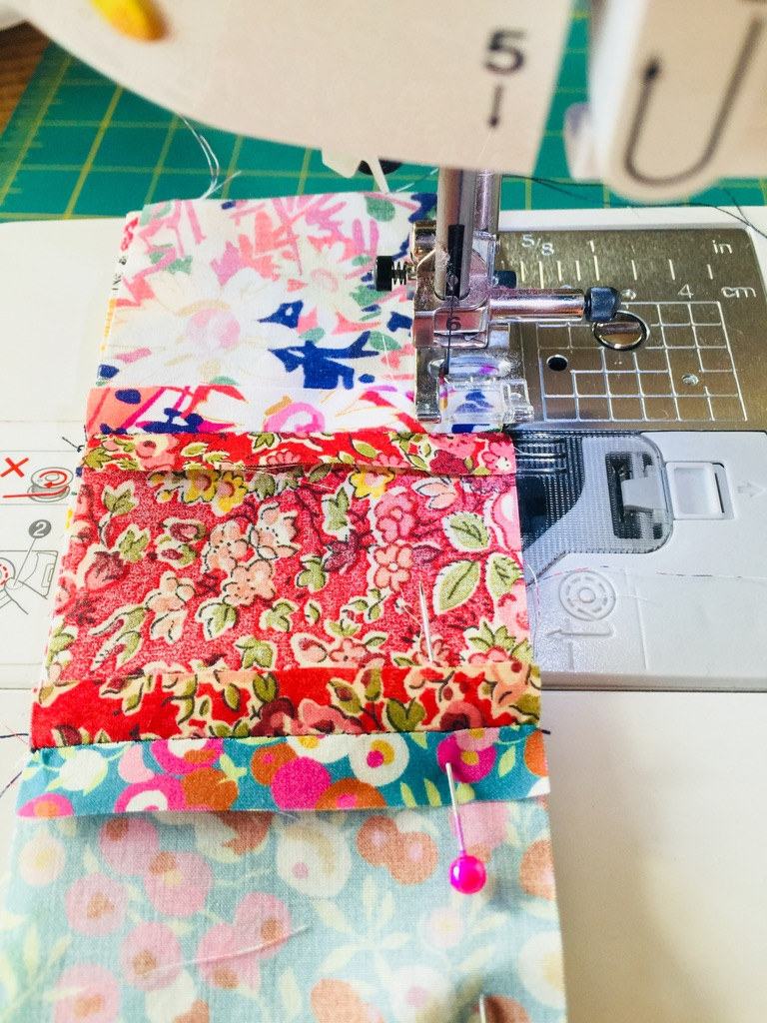
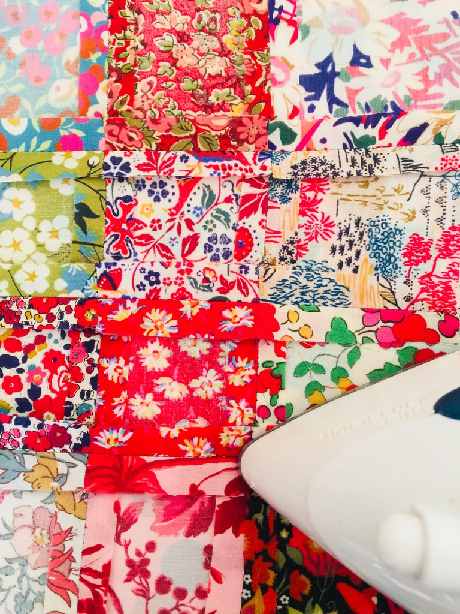
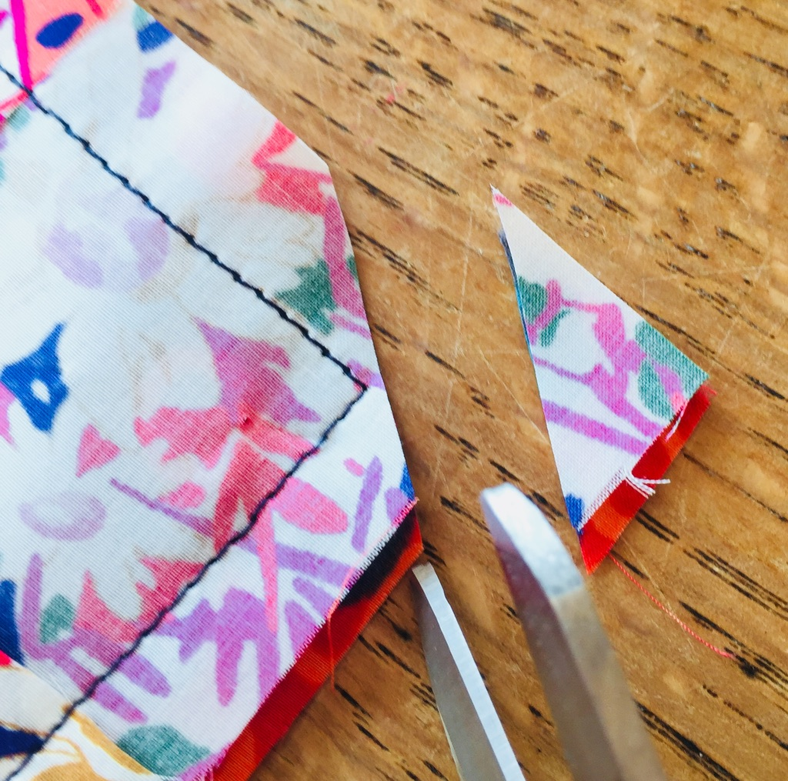
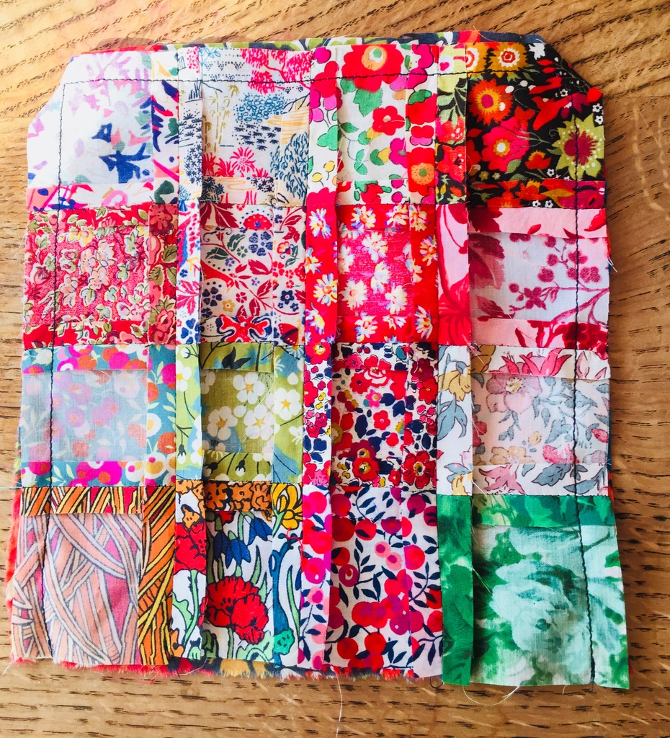
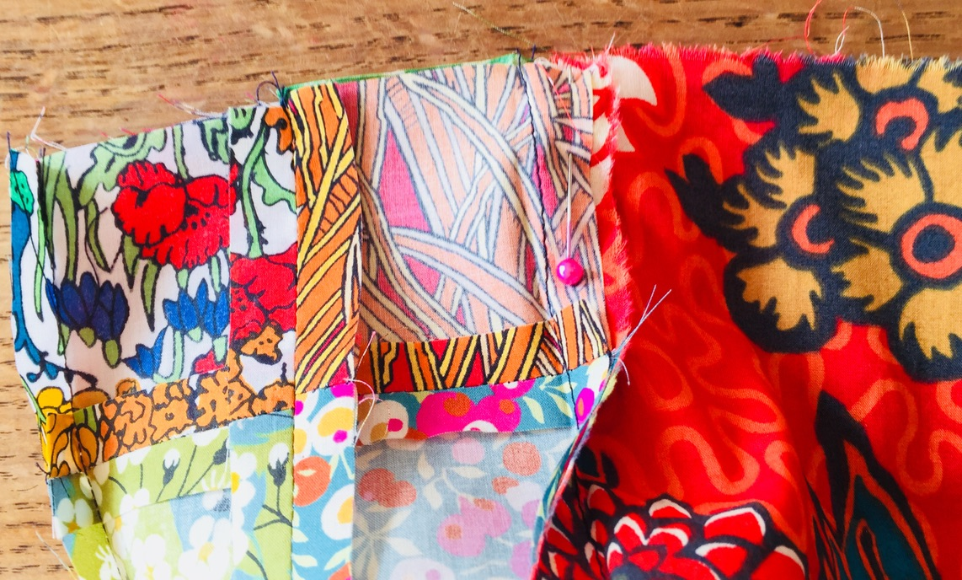
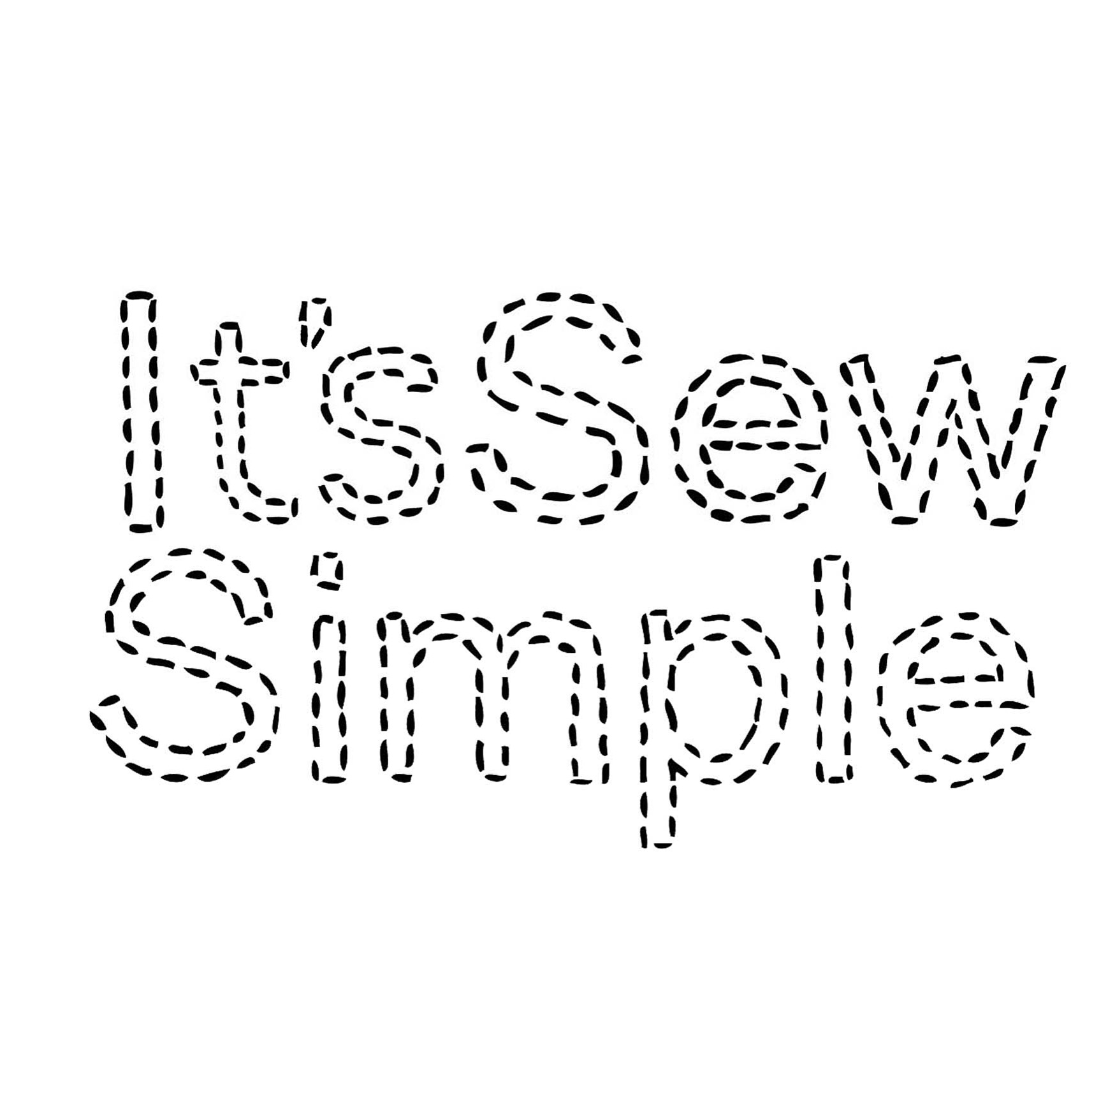
It’s sew simple to make a patchwork pincushion.
Materials needed:
16x2.5cm squares
20cm by 20cm cotton
Toy stuffing
Needle and thread
Iron &ironing board
Fabric scissors
Sewing machine
Pins
1. Pin each square together right sides facing each other, using only one pin per square.
2. Pin 4 rows, 4 squares in each row first before you sew, edge to edge.
3. Sew 0.5cm seam allowance. Always trim lose thread as you sew.
Carefully iron each seam open, use the tip of the iron.
4. Carefully iron each seam open, use the tip of the iron.
5. With right sides facing each other, join each row together with a pin at each seam. Place the pin directly through seam to seam, so the seams will match. Check each seam by looking at the right side, alter pin and seam matching and alter if necessary. To give you reassurance you may prefer to tack the seam before you sew and the remove the pins, this is totally optional. Taking your time always pays off in the end.
6. Sew each row together one row at a time.
7. Press each row as you complete, do not leave till they are all sewn. Once sewn press from the right side.
8.. Trim the two corners.
9. With right sides facing each other pin the patch work to the 20cm square.
10. Sew 0.5cm around 3 edges only.
11. Now open the opening like a crisp packet and pin the seams together. Sew half way across, leaving a 9cm opening.

Slide 2
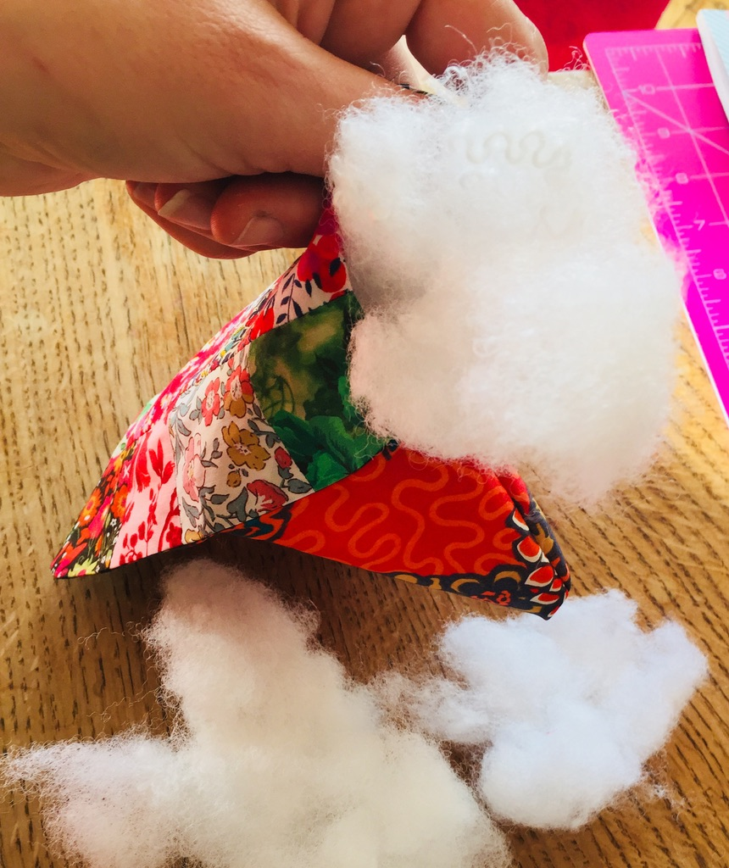
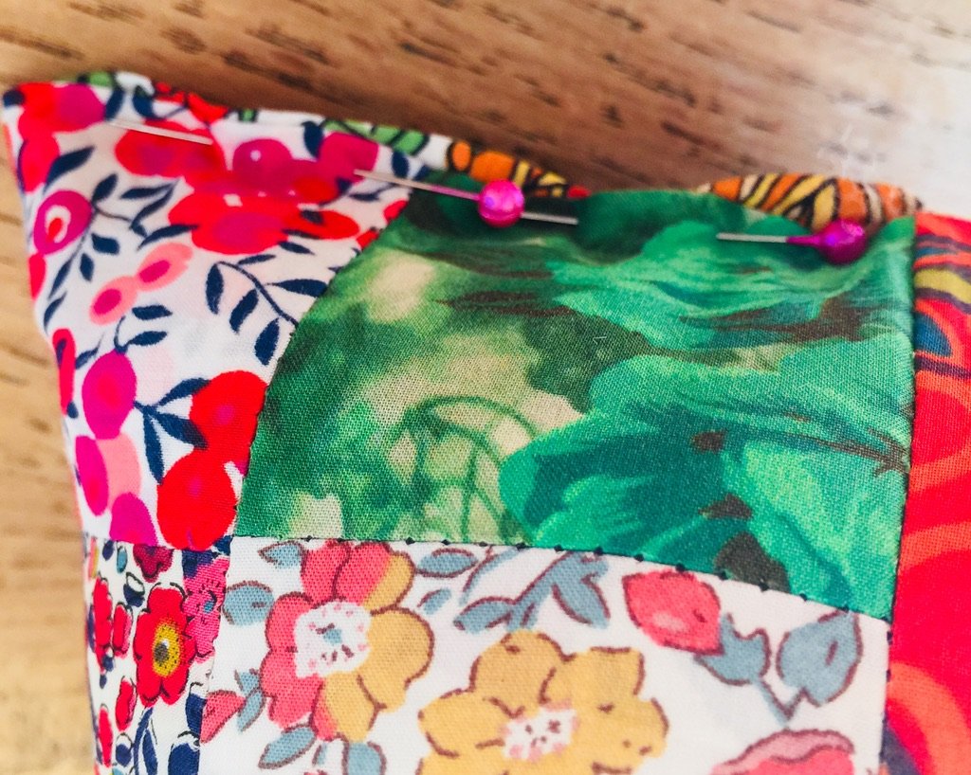
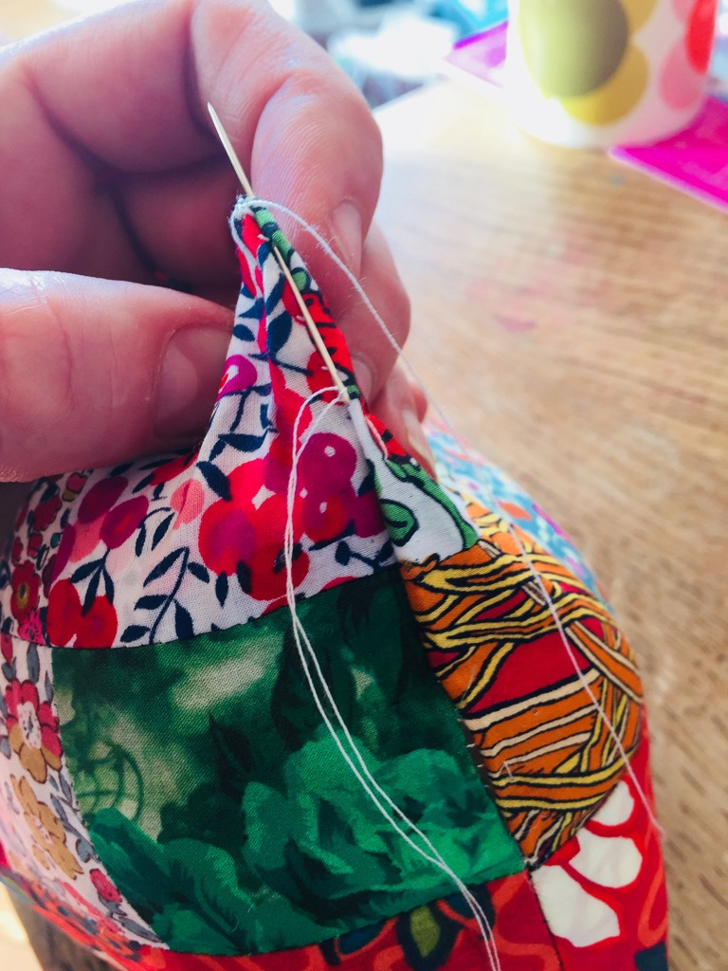
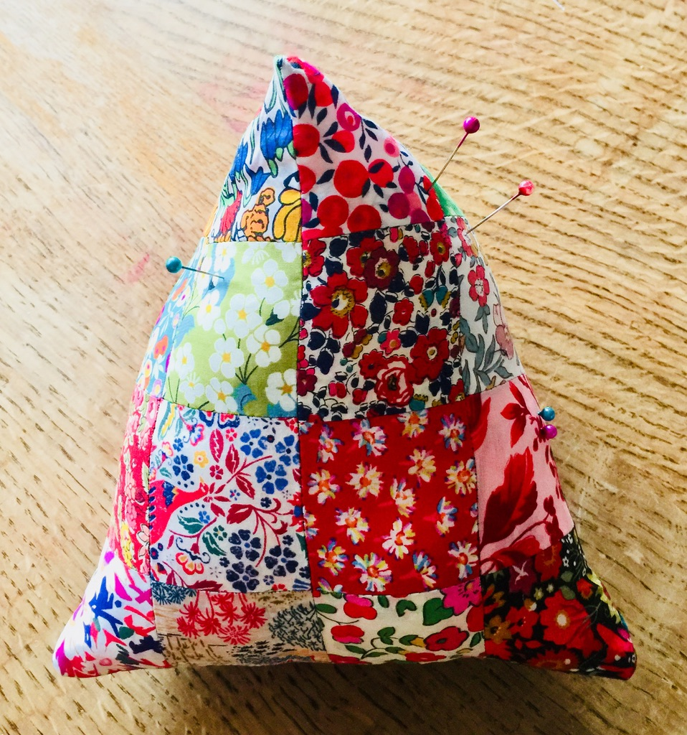
10. Now open the opening like a crisp packet and pin the seams together.
Sew half way across, leaving a 9cm opening.
11. Bag inside out and push the corners out with the end of your scissors or a pencil.
12. Fill with toy stuffing, make sure it is firm to touch.
Pin the opening closed, then slip stitch. This is the neatest way to close the gap, make sure the seams match up.
It really is sew simple!

